Slide 1

Human Activity Identification
Presented by:
Student Name Roll No
Neha Marne 72001247D
Isshita Paliwal 72001240G
Akansha Jagtap 72001241E
Guided By:
Mr. M.P. Wankhede

Slide 2
Outline
Introduction
Motivation
Problem statement
Objectives
Software and hardware requirement
Literature Survey
System Architecture
Data flow diagram
UML diagram
Proposed Algorithm
Conclusion
References

Slide 3
Introduction
Human activity recognition plays a significant role in human-to-human interaction and interpersonal relations. The human ability to recognize another person's activities is one of the main subjects of study of the scientific areas of computer vision and machine learning.
This technology has the potential to be used in automated activity profiling systems which produce a continuous record of activity patterns over extended periods of time.
Such activity profiling systems are dependent on classification algorithms which can effectively interpret and identify different activities.

Slide 4
Motivation
Human activity recognition basis for many applications such as video surveillance, health care, and human-computer interaction.
To Analyse the activity of a person from the information collected by different devices. Discover which are the variables that determine which activity is doing a person.
To Calculate a predictive model that can recognize a person's activity.

Slide 5
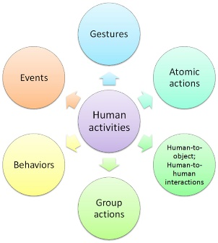
Problem statement
Human Activity Recognition is the problem of predicting what a person is doing based on a trace of their movement
Human activity recognition is a field of study that deals with identifying, interpreting, and analysing the actions specific to the movement of human beings.

Slide 6
Objectives:
To identify a method achieving more accurate human activity recognition by using suitable tools.
To propose a mechanism of an automated analysis or interpretation of ongoing events and their context from video data.
To explore better approach for action recognition based on using the suitable types of data to balance the use of features by strengthen the weak part in each type by the strong part in the other.
To recommend effective methods for the most cost-effective human activity recognition.

Slide 7
Software and hardware requirement
Software Requirement:
Operating System: Windows 10
Programming Language:Python
IDE: VS Code
Framework: Django
Hardware Requirement:
Processor: Intel Core I5
RAM: 8 GB or Higher
HardDisk: 500 GB

Slide 8
Literature Survey
Sr.no | Title | Author | Abstract
1 | Human motion analysis: A review. | Aggarwal and Cai (1999) | Human motion analysis, tracking from single view and multiview cameras, and recognition of human activities.
2 | A survey of advances in vision-based human motion capture and analysis | Moeslund et al. (2006) | Mainly focused on pose-based action recognition methods and proposed a fourfold taxonomy, including initialization of human motion, tracking, pose estimation, and recognition methods.

Slide 9
Sr.no | Title | Author | Abstract
3 | Deep Convolutional Neural Networks for Human Action Recognition Using Depth Maps and Postures | Aouaidjia Kamel, Bin Sheng, Po Yang, Ping L, Ruimin Shen, David Dagan Feng(2018) | Presented a method (Action-Fusion) for human action recognition from depth maps and posture data using convolutional neural networks (CNNs).
4 | Exploiting temporal information for 3D human pose estimation | Mir Rayat Imtiaz Hossain, James J. Little(2018) | Utilize the temporal information across a sequence of 2D joint locations to estimate a sequence of 3D poses. We designed a sequence-to-sequence network composed of layer-normalized LSTM units with shortcut connections connecting the input to the output on the decoder side and imposed temporal smoothness constraint during training.

Slide 10
Sr.no | Title | Author | Abstract
5 | Efficient Frequency Domain Feature Extraction Model using EPS and LDA for Human Activity Recognition | Rasel Ahmed Bhuiyan, Nadeem Ahmed (2020) | Enveloped Power Spectrum (EPS) is used for extracting impulse components of the signal, and the Linear Discriminant Analysis (LDA) is used as a dimensionality reduction procedure to extract the discriminant features for human daily activity recognition. After completing EPS feature extraction techniques, LDA is performed on those extracted spectra for extracting features using the dimension reduction technique. Finally, the discriminant vocabulary vector is trained by the Multiclass Support Vector Machine (MCSVM) to classify human activities
6 | Human Activity Recognition Using Pose Estimation and Machine Learning Algorithm | Abhay Gupta, Kuldeep Gupta, Kshama Gupta and Kapil Gupta(2021) | A single person poses estimation and activity classification using pose. Pose Estimation consists of the recognition of 18 body key points and joints locations. We have used the OpenPose library for pose estimation work. And the activity classification task is performed by using multiple logistic regression.

Slide 11
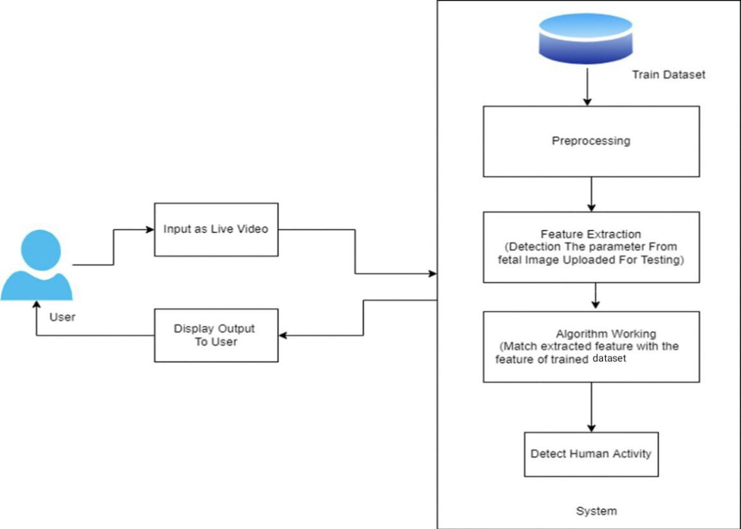
System Architecture

Slide 12

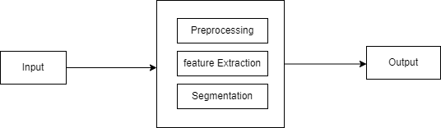
Data Flow Diagram
Level 0 :
Level 1 :

Slide 13
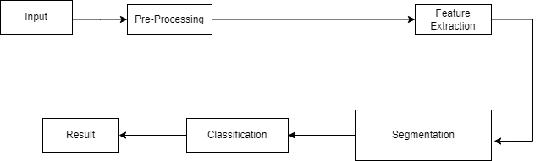
Data Flow Diagram
Level 2 :

Slide 14
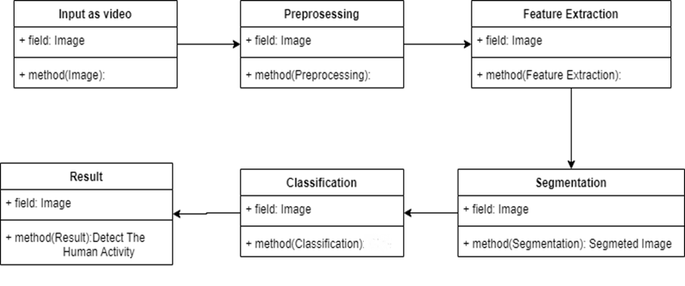
UML Diagram
Class diagram :

Slide 15
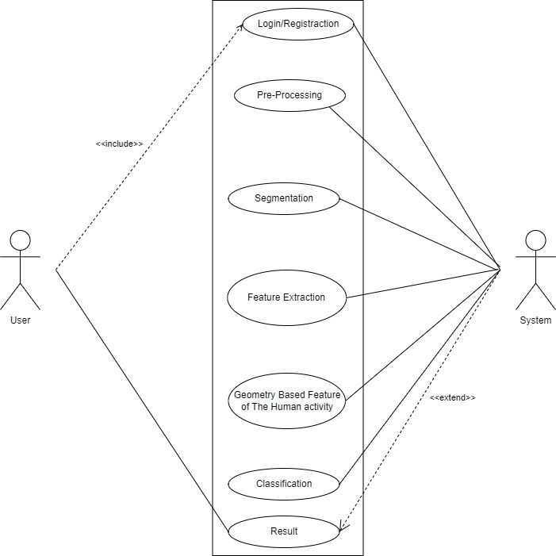
Usecase Diagram:

Slide 16
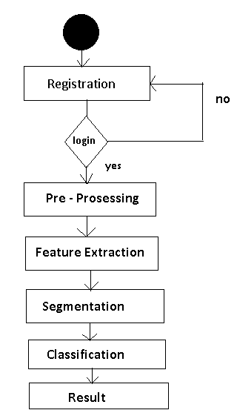
Activity Diagram:

Slide 17
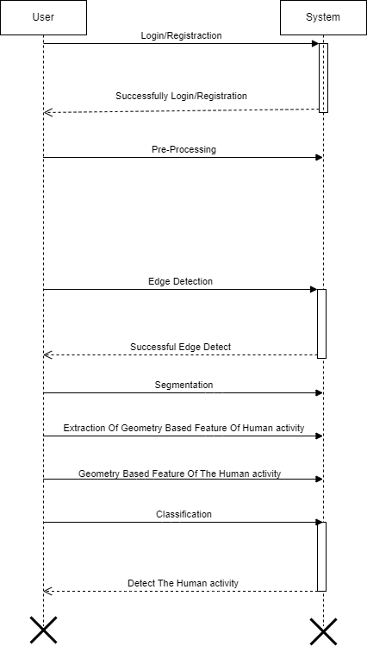
Sequence Diagram:
Feature Extraction
Successful Feature Extraction

Slide 18
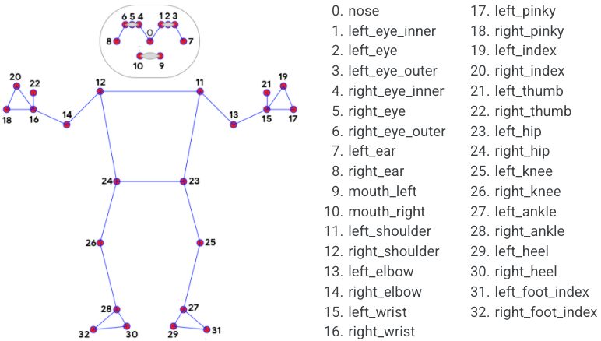
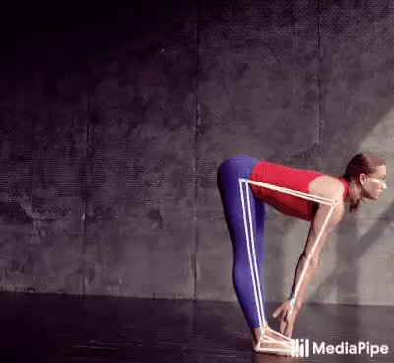
Proposed Algorithm
Pose Estimation:
Pose estimation is a computer vision task that infers the pose of a person or object in an image or video.
Pose estimation is the problem of determining the position and orientation of a camera relative to a given person or object.
This is typically done by identifying, locating, and tracking a number of keypoints on a given object or person. For objects, this could be corners or other significant features. And for humans, these keypoints represent major joints like an elbow or knee.
The goal of our machine learning models are to track these keypoints in images and videos.

Slide 19
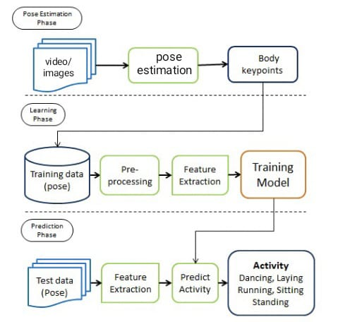

Slide 20
Timeline chart:
Activities | Aug | Sep | Oct | Nov | Dec
Submission of project ideas.
Project Topic Discussion.
Approval of project idea.
First presentation about progress of project work(Review1 and Review2)
Submission of Stage1 report.
Activities | Jan | Feb | Mar | Apr
Submission of stage1 report.
Start of implementation.
Presentation about progress of project work.(Review 5& Review 6)
Presentation about progress of project work.(Review 7& Review 8)
Submission of report for checking.
Final submission of report and project.

Slide 21
Conclusion
We have proposed a Human Activity Identification system based on pose estimation and classification algorithm.
This system will combine the results of the 3D pose estimation model with the classification algorithm for better and more accurate detailed result generation.

Slide 22
References
Aggarwal, J. K., & Cai, Q. (1999). Human motion analysis: A review. Computer vision and image understanding, 73(3), 428-440.
Kamel, A., Sheng, B., Yang, P., Li, P., Shen, R., & Feng, D. D. (2018). Deep convolutional neural networks for human action recognition using depth maps and postures. IEEE Transactions on Systems, Man, and Cybernetics: Systems, 49(9), 1806-1819.
Hossain, M. R. I., & Little, J. J. (2018). Exploiting temporal information for 3d human pose estimation. In Proceedings of the European Conference on Computer Vision (ECCV) (pp. 68-84).
H. P. S. A. Lateef and U. Eranna, "Modelling Approach to Select Potential Joints for Enhanced Action Identification of Human," 2018 International Conference on Electrical, Electronics, Communication, Computer, and Optimization Techniques (ICEECCOT), 2018, pp. 1506-1509, doi: 10.1109/ICEECCOT43722.2018.9001313.

Slide 23
R. A., Amiruzzaman, M., Ahmed, N., & Islam, M. R. (2020, August). Efficient Frequency Domain Feature Extraction Model using EPS and LDA for Human Activity Recognition. In 202020 3rd IEEE International Conference on Knowledge Innovation and Invention (ICKII) (pp. 344-347). IEEE.
Gupta, Abhay, Kuldeep Gupta, Kshama Gupta, and Kapil Gupta. "Human Activity Recognition Using Pose Estimation and Machine Learning Algorithm."

Slide 24
Thank You!

